Slide 1
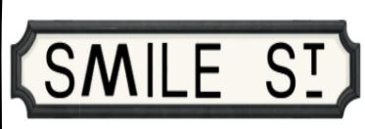
Streets Ahead

Slide 2

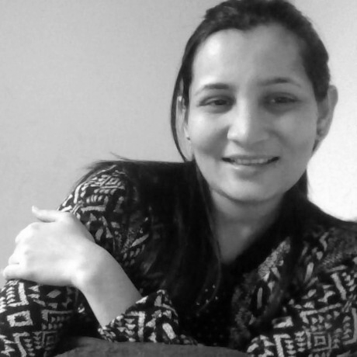
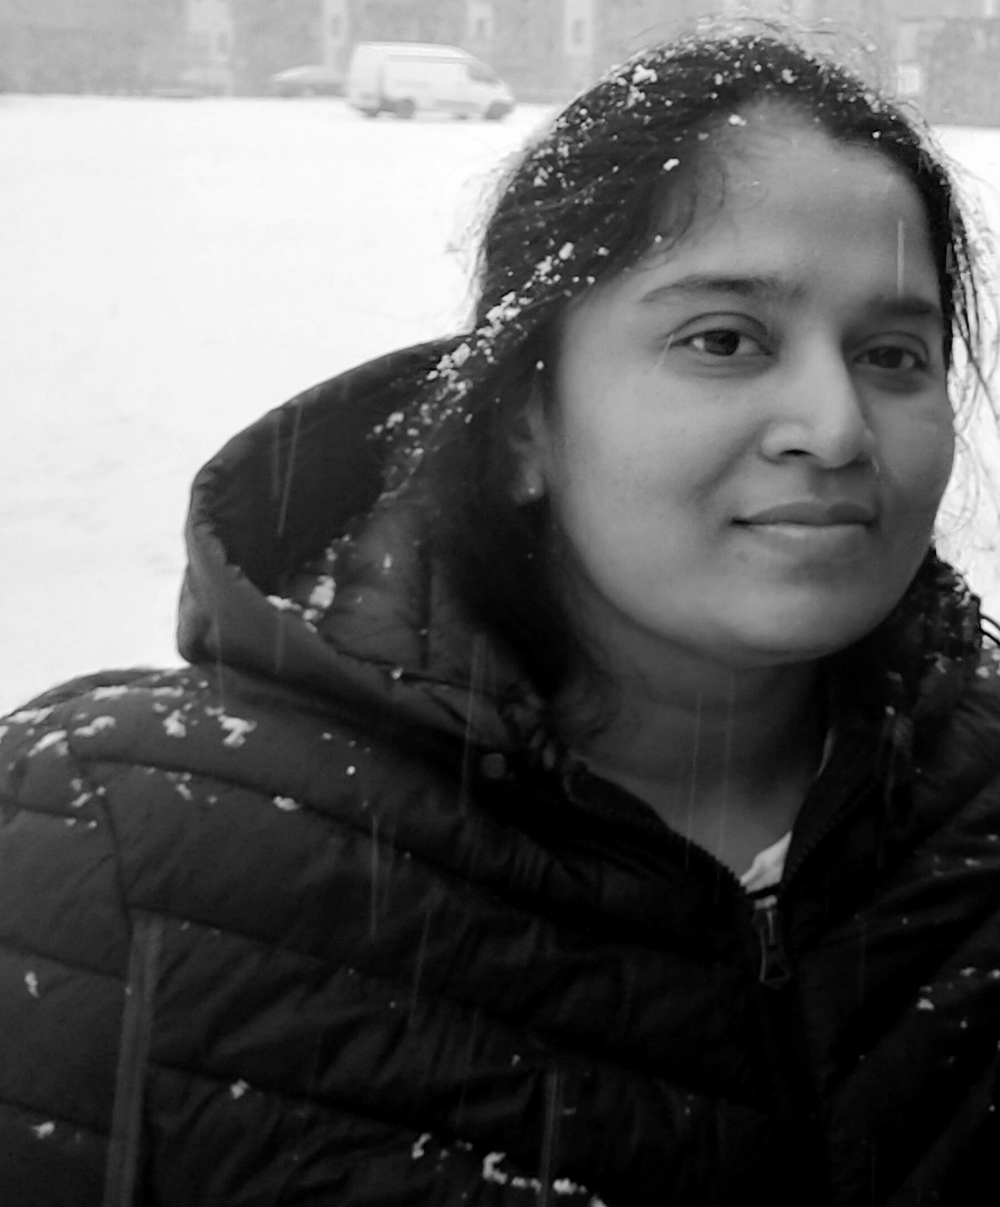
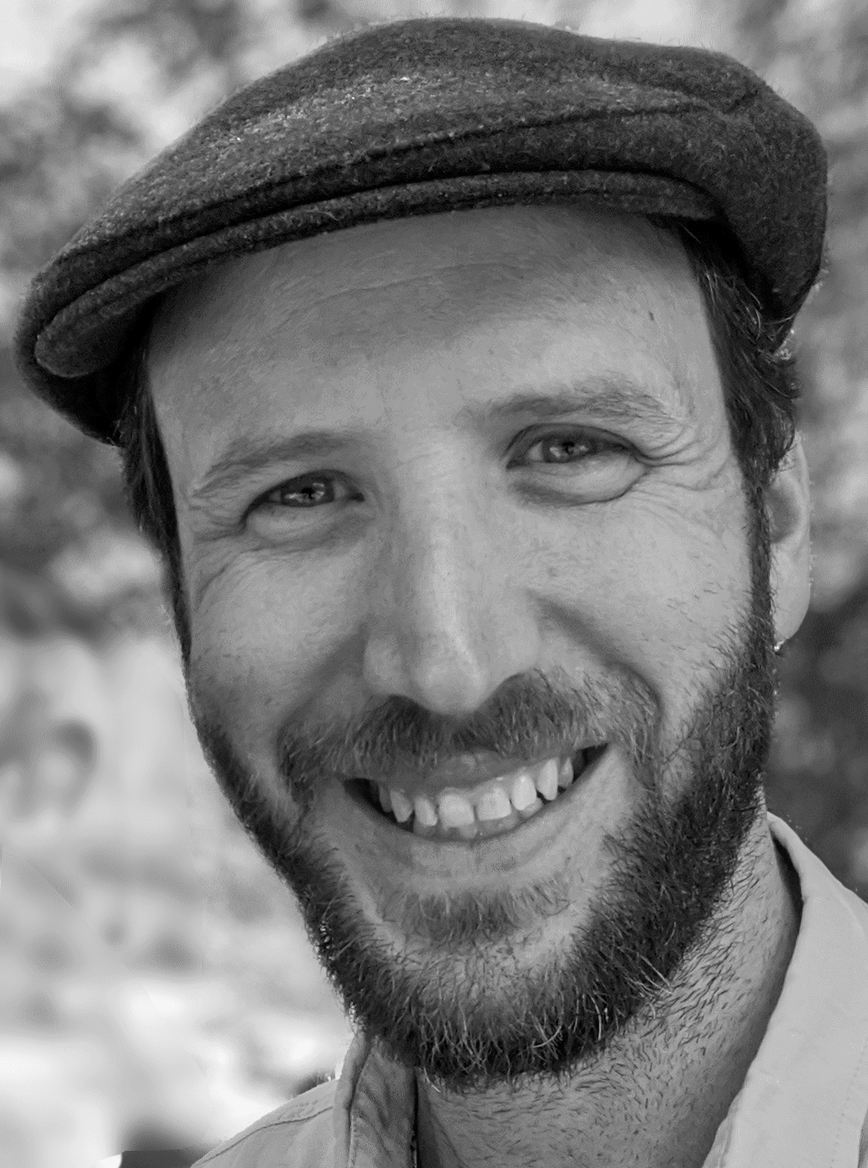
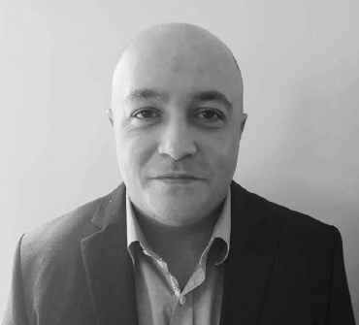
The team
Taslima
Ariel
Pushpa
Viran

Slide 3
The Problem
Notes:
Especially with the rapid development of Corona Virus , volunteering has become more important than ever. Our client , Street Group grants their employees two paid volunteer days but have found these days are underutilised .Employees are busy so they are looking for a simple and seamless experience. The aim of our team is to build a web application which simplifies the advertising of volunteering opportunities and to automatically pair an employee with Good Cause , manage updates ,notifications and calendars.

Slide 4

BrainSTorming
Similar apps- BeWorthwhile
Recommender system.
Similar Apps - BeWorthile
Handling natural language, stop words, ngrams
Looking at previous team presentations
Database modelling / code first database first
Domain language
Single Page versus MVC
C# versus Python
SQL versus NoSQL

Slide 5
The Process
Daily standup.
Using Google Docs for agenda and minute taking for meetings.
GitHub for codebase collaboration
Trello board for managing team
Balsamiq for wireframing.
Notes:
The team started by getting to know each other, and understanding each others strengths, what each person wants to get from the program and working patterns. It is a really interesting mix as some have recent project experience or have built SPA or MVC with different languages or have specialised in data and analytics. We are enjoying it. We chose to work 6 days with a daily standup. We started by setting up Google Docs to collect minutes of our meetings, set up a GitHub organisation and Trello board for sprint planning. (Next slide.)

Slide 6
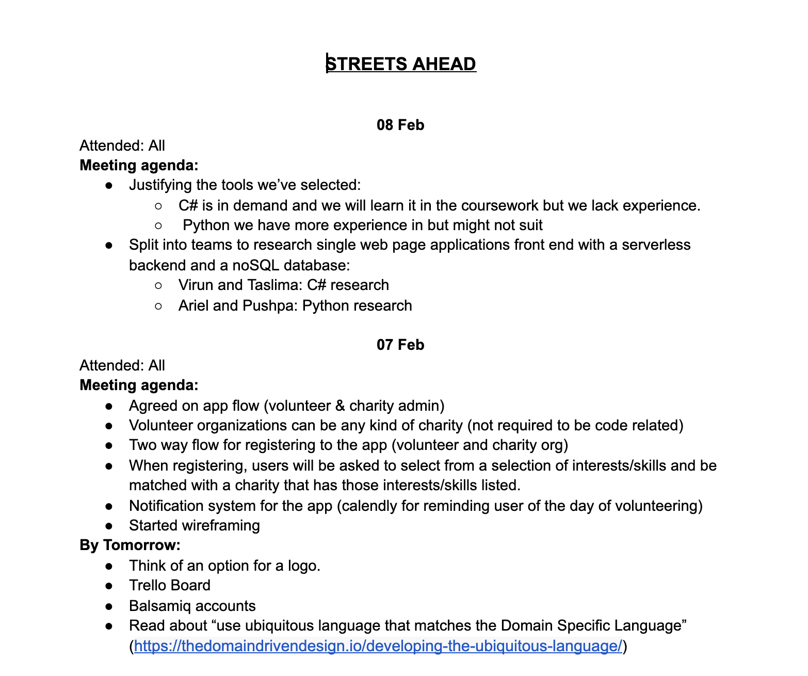

Slide 7
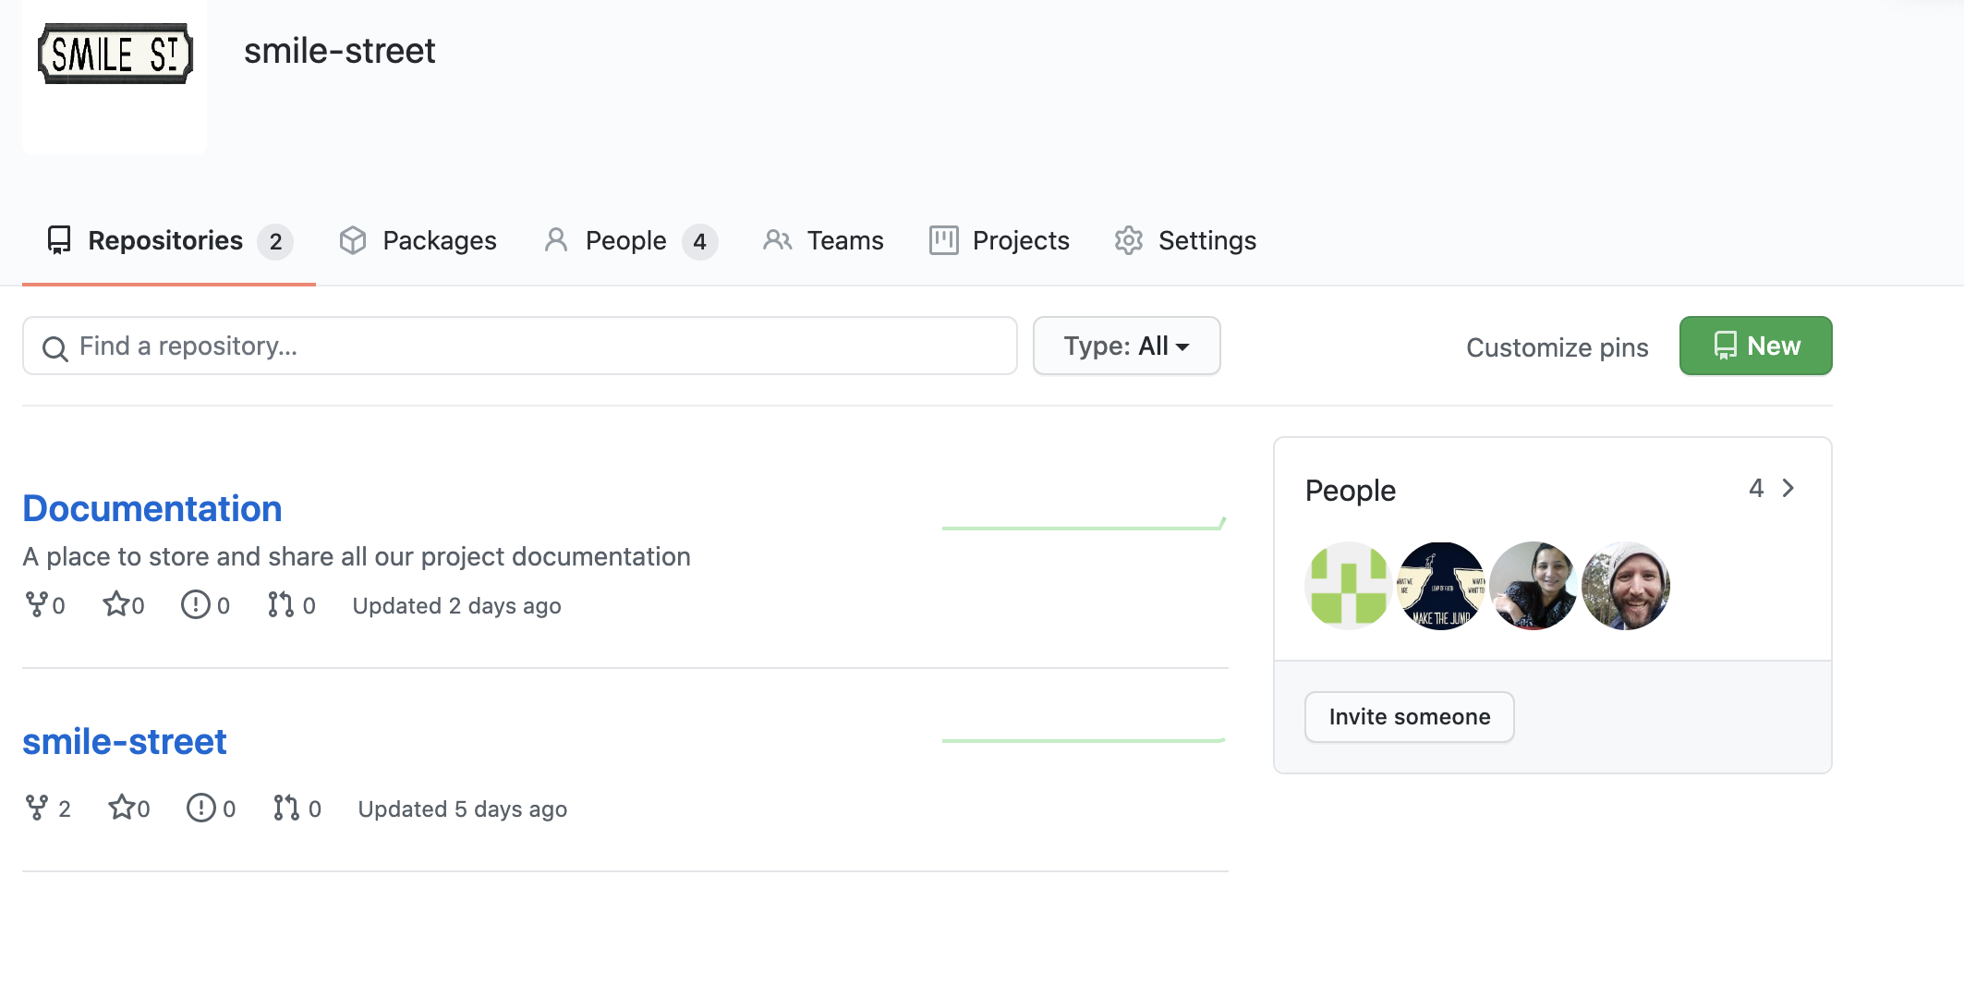

Slide 8
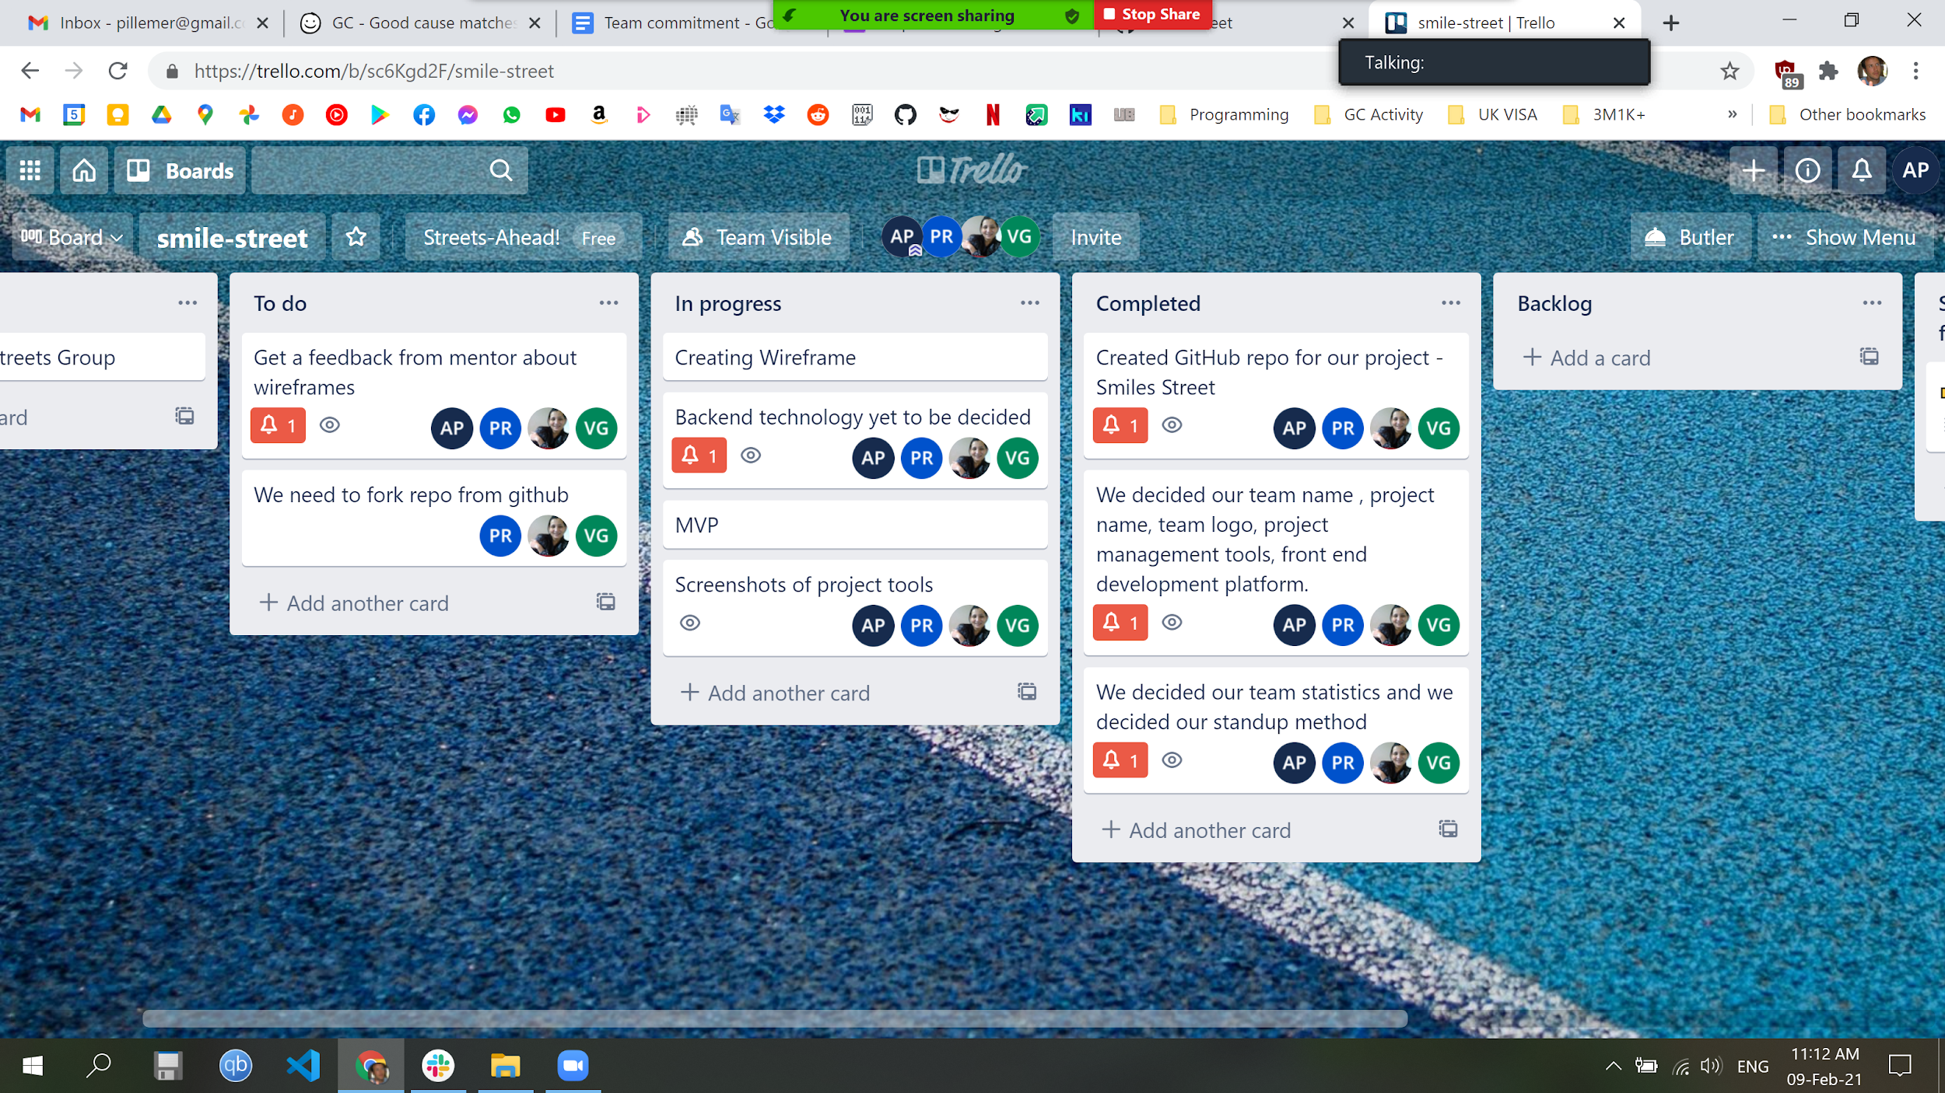
Notes:
This is our initial trello board. The reason we chose Trello versus Jira is because some members didn’t know any of the tools so were learning by using Trello.. and it was faster to setup and more user friendly. We chose Scrum as opposed to Kanban for our agile framework because because this is a short-iteration, small scale project with distinct beginning and ends for each iteration whlst Kanban is more suited to a larger incremental (not iterative) development cycle.

Slide 9
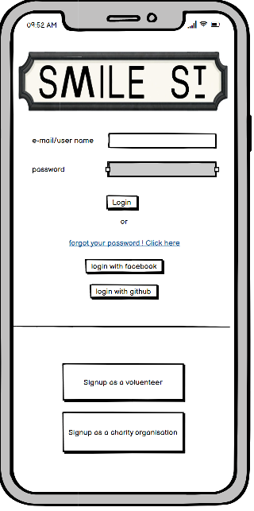
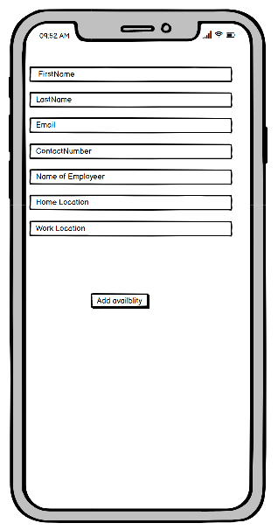
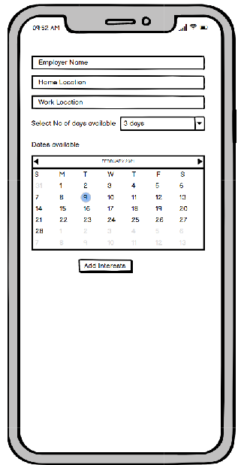
Notes:
We used Balsamiq for wireframing the minimum viable product as mentioned in the brief.. We chose Balsamiq versus pen and paper as it was easy to set up, fast to learn and collaborate in real-time. At this stage, we also looked to include domain specific language, directly from the user story’s into the wireframes so that it would filter down for naming conventions when we start coding, building objects and their attributes. Here you see the minimum viable product starting with the ‘volunteers journey’. For usability, we decided to break up the sign-up procedure across three pages. Starting from the left, they would sign up or login. If signing up, input their details and their availabilities then press the button to “add interests”.

Slide 10
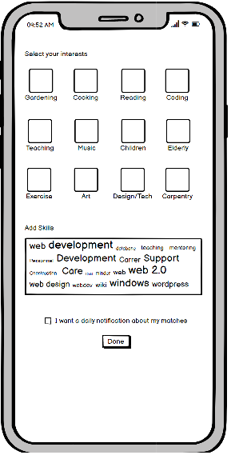
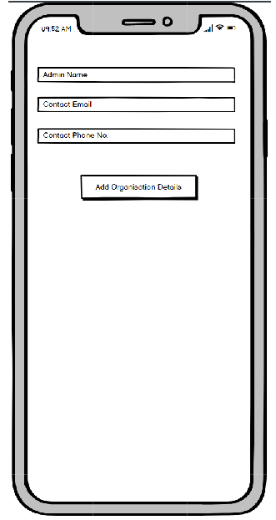
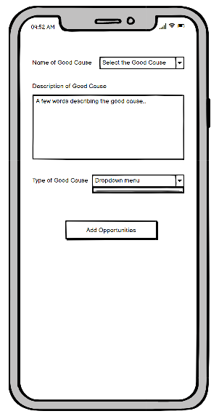
Notes:
The volunteers journey then move to the first wireframe where they select their interests and add their skills. The second wireframe starts the Good-cause-admin’s journey. They input their own details then on the third wireframe, they input the ‘good cause’ details and press to “add opportunities”.

Slide 11
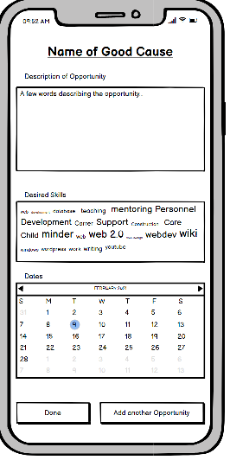
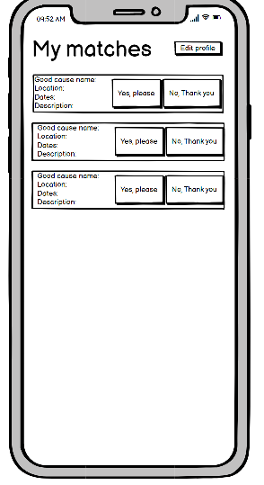
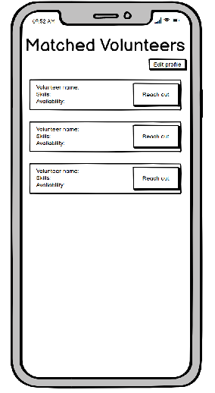
Notes:
On the first screen, a charity-admin is adding opportunities, skills required and dates that those opportunities are live. They can add multiple opportunities on this page. All previous slides are regards, registration and information about opportunities. The second slide on this page shows the matched opportunities for the volunteer, matched by location, dates and description of opportunities versus the volunteers skills offered. The third slide shows the matched volunteers for the ‘good cause’.

Slide 12
Going ForWards
Notes:
Define the MVP
Mocking up of code in HTML and CSS
After that converting it to REACT
Studying SPA versus MVC with different technology.
I am now going to hand over to you Taslima and Pushpa.

Slide 13
Thank you and Questions
Notes:
Q:

